Slide 1

MEDICINAL LEAF CLASSIFICATION USING IMAGE AUGMENTATION AND MOBILENETV2
Under the Esteemed Guidance of
Mrs. G. JYOTHI
(Assistant Professor)
Department of Information Technology
Team Members
D.MOUNIKA 21L31A1213
N.SIDARTHA 21L31A1240
P.TANUSHA 21L31A1241
P.CHAITANYA 22L35A1201
J.MANOJ 22L35A1204
DEPARTMENT OF INFORMATION TECHNOLOGY

Slide 2
ABSTRACT
This project uses image processing and MobileNetV2 to identify medicinal plants. Users can upload or take pictures of plant leaves, and the application will provide accurate identification and helpful information. Built with Python and Flask, the application has a simple interface and chat bot. It is useful for Ayurvedic practitioners, scientists, students, and anyone interested in plants. The application analyzes the image’s features and uses MobileNetV2 to classify the plant leaves. Future updates will add more plant images and improve the system’s accuracy. This project is a helpful tool for research and learning in the fields of medicine and biotechnology.

Slide 3
Introduction
We are creating an application that helps people easily identify medicinal plants, which can be difficult without expert knowledge. Many plants are used in traditional medicine, but recognizing them can be a challenge. This application uses image processing and mobileNetV2 to analyze plant photos and provide accurate identification, along with information on their medicinal uses. This tool is useful for researchers, healthcare providers, students, and anyone interested in plants, making plant identification faster, easier, and more accurate to support research, healthcare, and safe use of medicinal plants.

Slide 4
Background work
Studied research papers and existing applications related to plant identification using image processing and machine learning.
Explored Ayurvedic plant classification techniques and traditional methods of plant identification.
Researched on feature extraction techniques such as color histograms, shape analysis, and texture recognition.
Studied OpenCV for preprocessing images, including resizing, noise reduction, edge detection, and segmentation.
Explored various machine learning algorithms, including Convolutional Neural Networks (CNNs), Support Vector Machines (SVMs), and Random Forest classifiers. Chose CNNs due to their high accuracy in image classification tasks.
Trained the model on datasets of medicinal plants from sources like Plant CLEF, Kaggle, and self-collected images.
Collected and curated a dataset of medicinal plant images from open-source repositories and field research. Labeled the dataset with scientific names, common names, and medicinal properties. Applied data augmentation techniques to enhance model generalization.

Slide 5
Literature Review
S.No | Title of the Paper | Name of the Journal | Description
1 | Identification of Different Plants through Image Processing Using Different Machine Learning Algorithms | UGC Care journal Authors:Vikaho Swu , Dibya jyoti Bora | Identification of plants through plant leaves on the basis of their shape, color, and texture features using digital image processing techniques for classifying the plant species.Using different machine learning algorithms, Gaussian filtering, K-means clustering,Principal Components Analysis (PCA).
2 | Plant recognition system using leaf shape Features and minimum euclidean distance | ICTACT Journal | The study presents a plant recognition system using image processing to identify plants based on leaf features. Besides shape, additional features are considered to

Slide 6
Literature Review
S.No | Title of the Paper | Name of the Journal | Description
 |  |  | improve accuracy. The system involves image pre-processing, feature extraction, and matching using the minimum Euclidean distance method. Tested on 50 images from 10 species in the Flavia dataset, it achieved over 90% accuracy. While effective, it is slow and needs further improvement for larger datasets.

Slide 7
System Analysis
System Requirements
Software:
Operating System: Windows / Linux / macOS
Programming Language: Python
Libraries & Tools: OpenCV, TensorFlow, Keras, NumPy, Pandas
Frontend: HTML/CSS/JavaScript (for UI)
Backend: Flask

Slide 8
Hardware:
Processor: Intel i5 or higher / AMD Ryzen 5 or higher
RAM: Minimum 8GB (Recommended 16GB for training models)
Storage: Minimum 10GB (For dataset and model storage)
GPU: NVIDIA GPU (Recommended for faster ML training)

Slide 9
Feasibility Study
Technical Feasibility:
The project leverages Python, Flask making it technically feasible due to their strong support for web and machine learning applications.
Image processing techniques using OpenCV and machine learning models such as MobileNetV2 ensure efficient plant classification.
The chatbot implementation using Natural Language Processing (NLP) enhances user interaction.
Operational Feasibility:
The application provides a simple and intuitive interface, making it easy for users like Ayurvedic practitioners, students, and researchers.
The system supports real-time image upload and classification, allowing instant identification of medicinal plants.
Future updates will improve accuracy by expanding the plant database and refining machine learning models.

Slide 10
System Analysis
Feasibility Study
Economic Feasibility:
Development costs are minimized by using open-source tools like Python, Flask, and TensorFlow.
Firebase offers affordable storage and authentication solutions, reducing infrastructure costs.
The system can be monetized by offering premium features or integrating with research institutions.

Slide 11
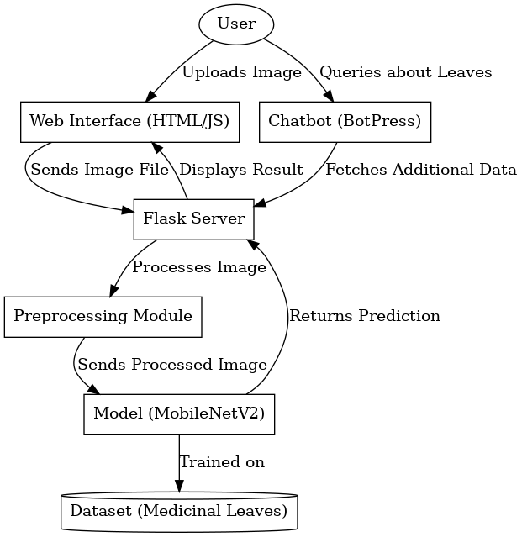
System Design
System Design

Slide 12
UML Diagrams
Use-case diagram:

Slide 13
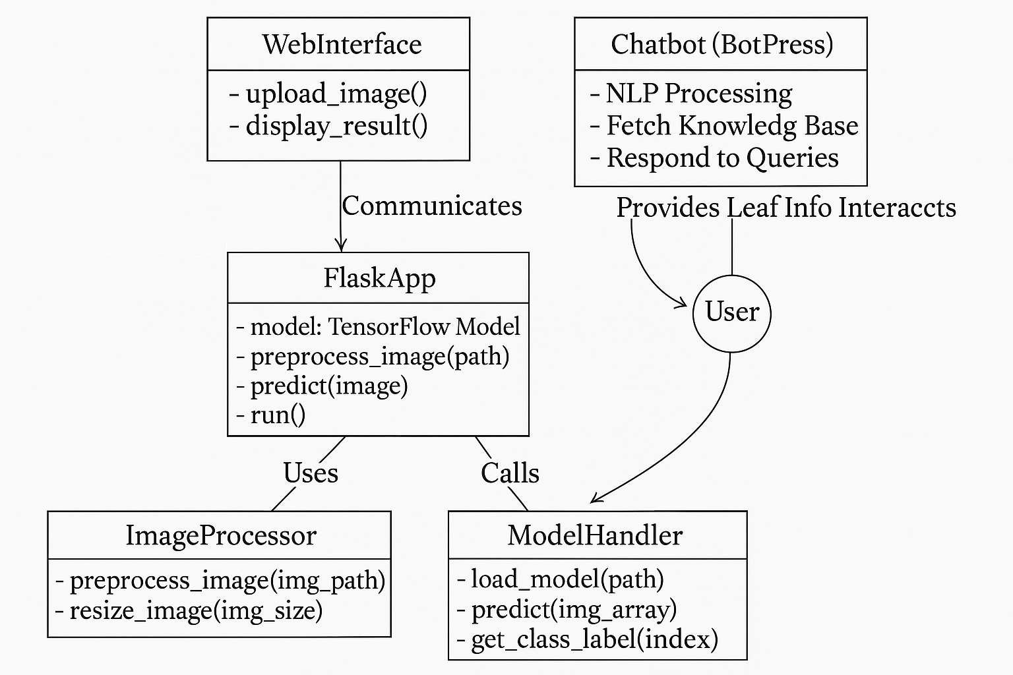
Class diagram:

Slide 14
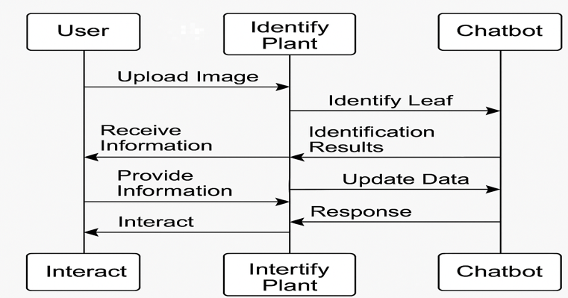
Sequence diagram:

Slide 15
Methodology
Image Upload: Users upload images of plant specimens through a mobile app.
Image Processing: Advanced algorithms like MobileNetV2 a powerful algorithm used for image classification and object detection that analyze plant features such as shape, color, and texture to extract relevant morphological data.
Machine Learning Classification: The system uses pre-trained machine learning models to accurately classify the plant species.
Information Retrieval: Once identified, the system provides detailed medicinal information about the plant, useful for practitioners and researchers.

Slide 16
System Testing
Testing Methodology
Unit Testing: Verify individual components function correctly. Image Processing Module (OpenCV) , Machine Learning Model (MobileNetV2 - TensorFlow), Chatbot, System User Input Handling
Integration Testing: Ensures seamless interaction between system modules (frontend, backend, database, ML model).
Functional Testing: Validate system functionality based on requirements.(Users can upload an image and get an accurate plant classification, The chatbot provides relevant plant information based on queries)
Performance Testing: Evaluates the system’s speed, responsiveness, and scalability.
Usability Testing: Assesses user experience, accessibility, and ease of navigation.
Security Testing: Ensures data privacy and security in the application.

Slide 17
System Testing
TID | Test Case Description | Test Result | Output
1 | Verify if the dataset of medicinal plants is loaded correctly | Pass | Dataset successfully loaded into Pandas
2 | Test image preprocessing (resizing, normalization) | Pass | Images processed and saved without loss

Slide 18
TID | Test Case Description | Test Result | Output
3 | Check if categorical variables (plant names, medicinal properties) are properly encoded | Pass | Label encoding applied successfully
4 | Validate dataset splitting for training and testing | Pass | Data split successfully without data loss
5 | Train CNN model for plant species classification | Pass | Model trains successfully with optimized parameters

Slide 19
TID | Test Case Description | Test Result | Output
6 | Validate Flask API integration with machine learning model | Pass | API returns accurate predictions for input images
7 | Test chatbot functionality for user interaction | Pass | Chatbot responds with correct medicinal plant information
8 | Evaluate system accuracy and classification performance | Pass | Model achieves expected accuracy levels

Slide 20
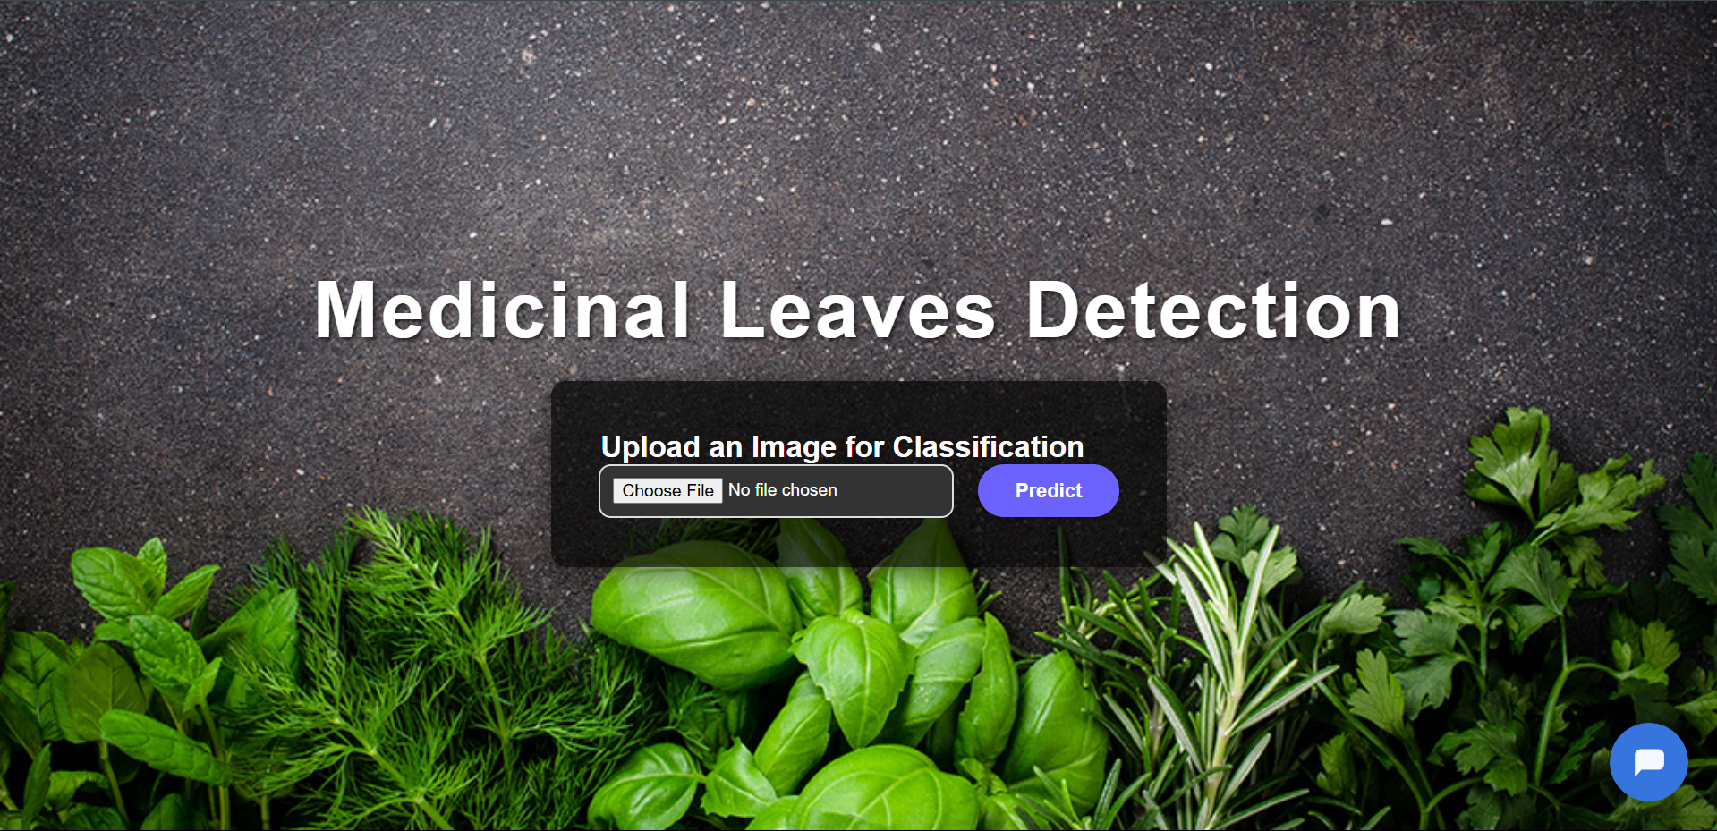
Results

Slide 21
Results

Slide 22
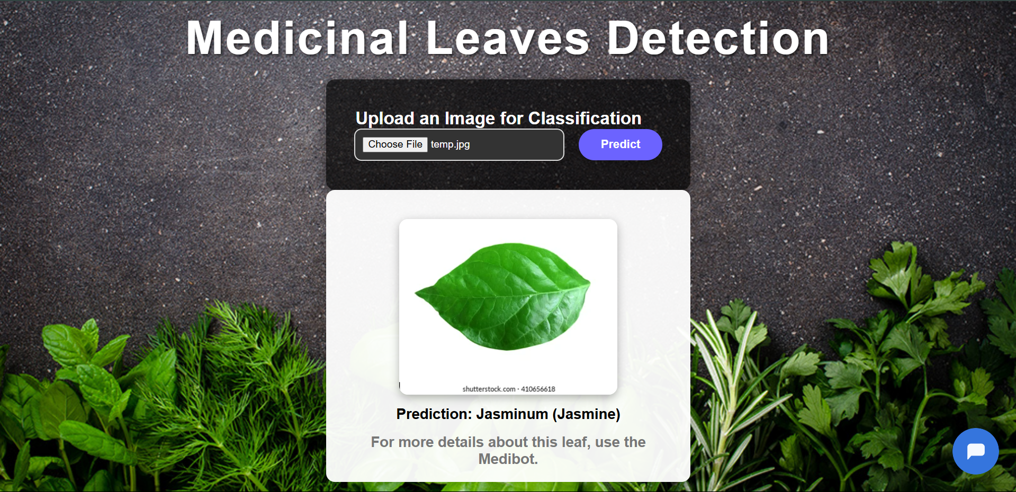
Results

Slide 23
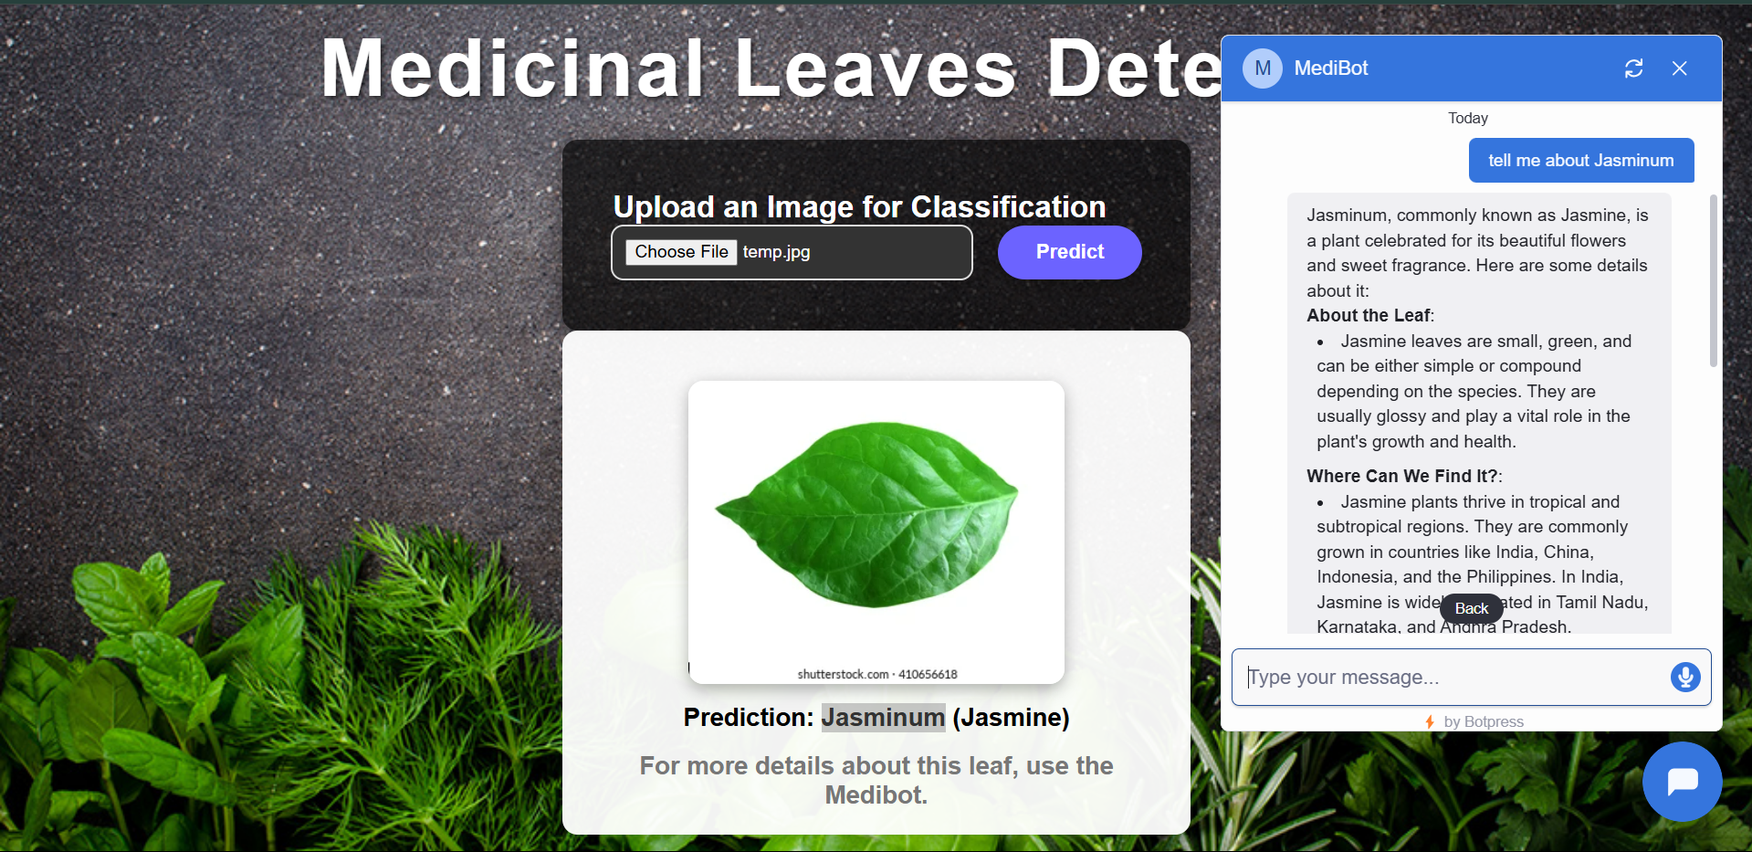
Results

Slide 24
Conclusion
The Medicinal Plant Detection project effectively integrates image processing and machine learning to identify medicinal plants, providing valuable insights for researchers, Ayurvedic practitioners, and plant enthusiasts.
By leveraging Python, Flask, and MobileNetV2, the system ensures accurate classification and user-friendly interaction, contributing to advancements in medicine and biotechnology.
Future enhancements will focus on expanding the plant database, improving classification accuracy, and integrating real-time plant recognition, further bridging technology with traditional medicine.

Slide 25
Thank You

